Slide 1
ToFD auto evaluation - Methodology

Slide 2
Initial detection of parabolic region
Scan image is divided into regions of size 300X300
Threshold is chosen for each region through Otsu’s thresholding
Canny Edge Detector is used to detect required parabolic areas. The thresholds for Canny Edge Detection is kept as Otsu’s threshold, 3 x Otsu’s threshold for each region
Hough Parabola is used to detect the parabolas from the detected edges

Slide 3
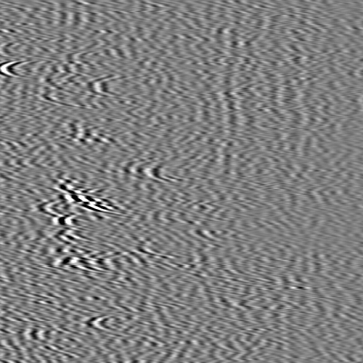
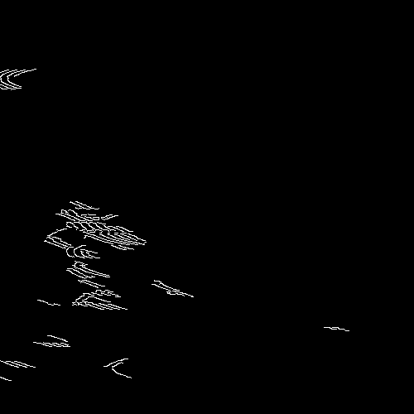
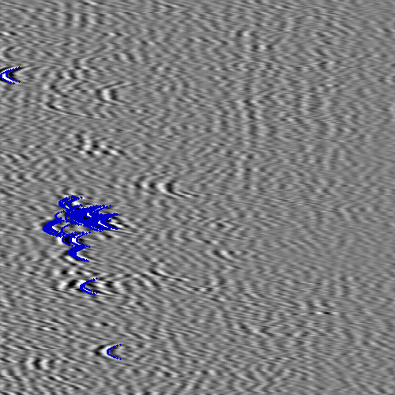
Adaptive Canny
Original Adaptive Canny Hough Parabola

Slide 4
Clustering Parabolas
The parabolas are separated into groups using K-means clustering
Bounding box is made based on lowest and highest coordinate values in a group

Slide 5
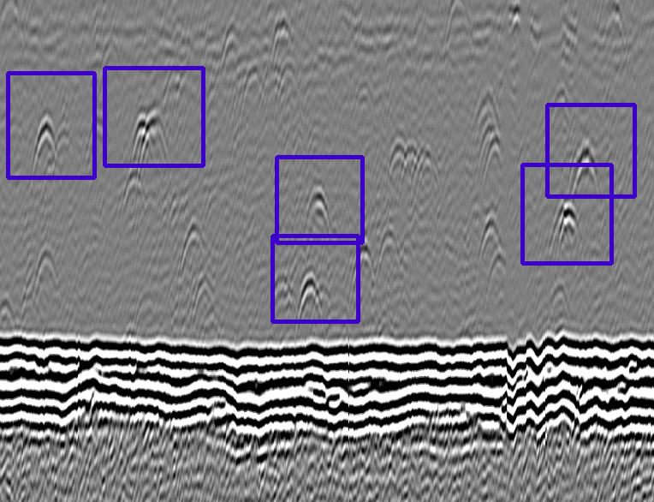
Bounding Box example

Slide 6
Specific detection of parabolas in bounding boxes
When the threshold is kept on the lower side, a number of redundant noisy areas are detected as bounding box
To eliminate them, parabolas are detected specific to bounding box a second time

Slide 7

Specific detection of parabolas in bounding boxes
Binary thresholding of region, keeping only pixels with colour intensity higher than overall upper threshold or lower than overall lower threshold
Image is segmented based on contours, and images with maximum contour area lower than a specific threshold are removed. This is done to remove noise
Hough parabola is used on each image to detect parabolas

Slide 8
A-scan analysis
A-scan is taken for the given x coordinate of a parabolic defect region detected through previous steps
This is used for precise location of defects which wasn’t possible with only image processing

Slide 9
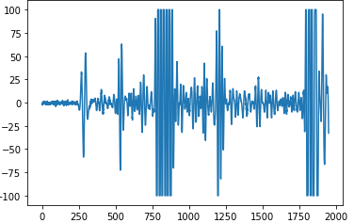
A-Scan for labelled defect
A-scan for entire width

Slide 10
A-scan analysis
The initial peak in the scan is labelled as the Lateral Wall
The approximate location of the defect region is known from previous steps, this region of the scan is focused on and the peaks of that part of the scan are identified
The region from the start of the first peak with magnitude above a threshold to the end of the last through with magnitude above a threshold is taken

Slide 11
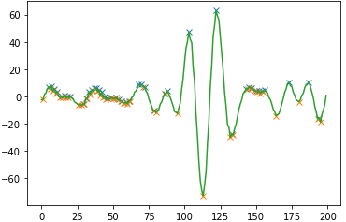
A-scan zoomed to Defect region
lateral wall
Labelled Defect
Detection of defect depth and lateral wall

Slide 12
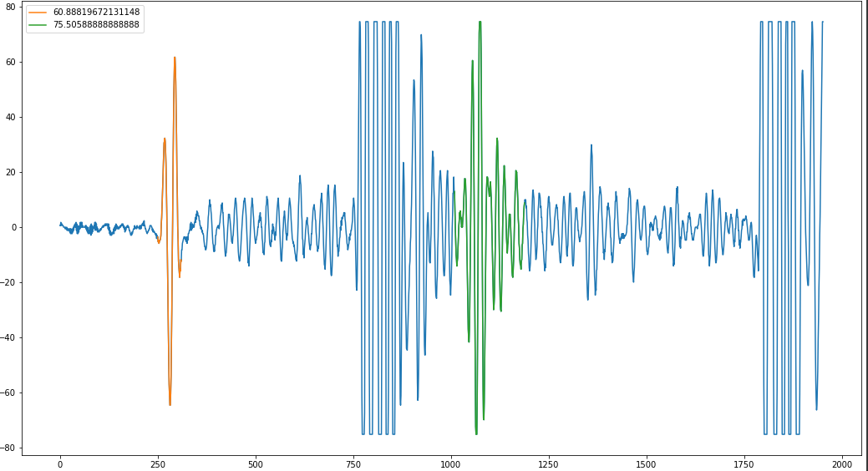
Detecting peaks from A-scan only
Thresholding values in A-scan in comparison to neighbouring regions
Selecting only regions with high Signal to noise ratio to reduce noisy regions

Slide 13
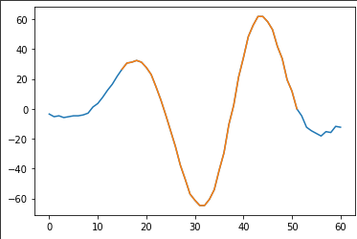
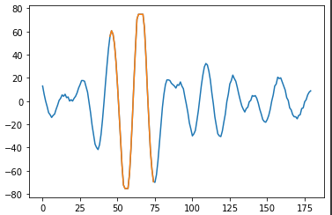
Selecting only peak region from Region of Interest

Slide 14
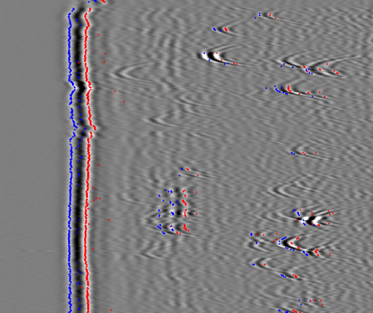
Final result for Sample A-scan

